Slide 1

National Honor Society
April 2025 - 7th Meeting

Slide 2
Leadership Contact
President: Urvi Mysore urvirm@madisoncity.k12.al.us
Vice President: Reese Freeman reesemf@madisoncity.k12.al.us
Sponsor: Mr. Thomas jlthomas@madisoncity.k12.al.us

Slide 3
Officers
Secretary: Lily Arnold - lilyba@madisoncity.k12.al.us
Parliamentarian: Vineet Vadrevu - vineetnv@madisoncity.k12.al.us
Treasurer: Luke Alverson - lukesa@madisoncity.k12.al.us
Historian: Kinsley Hardy - kinsleymh@madisoncity.k12.al.us

Slide 4
NHS Oath
I pledge to maintain high scholastic standing,
To endeavor intelligently and courageously to be a leader,
To give of myself freely in service to others,
And to hold as fundamental and worthy an untarnished character.
In so doing, I shall prove myself worthy
Of a place in the National Honor Society

Slide 5
New members,
save the date!
Honor Society Induction Ceremony:
May 7th @ Comp. Gym
5:00 pm
Free food and refreshments included (Chick Fil A)
Dress code: Semi-formal
All new members should have completed the Induction Attendance Form.

Slide 6
Officer Applications
NHS has received officer applications for the 2025-2026 school year.
Interviews will be conducted from Apr 28-May 2.
Applicants for Pres/VP received an interview scheduling form; please complete by Apr 21st!

Slide 7

Senior Stoles
Graduation stoles are free for all seniors.
Stole pickup:
  May 12th - May 16th
In A109, Mr. Thomas’s room
You can only pick up a stole for yourself - no pickups for friends!

Slide 8
Service Hours
Service hours were due April 11th.
We are currently processing all submitted hours.
Keep an eye on your GroupMe/email in case we need to contact you about hours.
We have a list of people we need to talk to immediately after this meeting.

Slide 9

Having a Productive Summer
Workshop
April 2025

Slide 10

Introduction
Summer is a great time to relax and unwind from the school year.
While this is necessary, it’s also important to take a few steps to ensure a successful new school year ahead.

Slide 11

Seek Opportunities to Grow
This could include finding a job to gain professional experience and to earn money.
You could also secure an internship in a specific field you are interested in.
  Learn technical skills
  Earn money toward college
  Boost your resume for college applications.

Slide 12

Study for and Take Standardized Tests
Especially for juniors and sophomores, the summer is a great time to focus on tests like the ACT and SAT.
Practice, join prep classes, and take official tests during the summer so that you won’t have to worry about it once the school year starts.
Focus on your struggle points
  It only takes a little bit of time and focus each day to improve.

Slide 13

Preparing for College Applications 2025-2026
Juniors, before the school year ends, ask a few teachers who know you well if they’d be willing to write you a recommendation letter.
Research colleges you’d be interested in applying to in the fall.
Start drafting your CommonApp personal statement early!
  Your first draft might be drastically different than what you end up submitting.

Slide 14

Preparing for College
College-bound seniors, if you have not already:
  Make sure you commit to your college by the deadline.
  Send all necessary documents (FAFSA, CSS, etc.) to receive your financial aid package.
  Do research on housing.
  Attend your college’s admitted student events in the summer

Slide 15
Get a Headstart on Service Hours for Next Year
United Cerebral Palsy of HSV
Volunteers will most likely be assigned to the following tasks: working guest check in, silent auction check out, heading the selfie wall, walking sponsors to their assigned tables, event setup, or event cleanup.
Friday June 20, 2025 (6-10pm)
Point of Contact: Kimi Birchler, 2568594900/kbirchler@ucphuntsville.org
1856 Keats Drive Northwest, Huntsville, AL, USA
Manna House
Assist with food preparation and distribution, clothing distribution, etc. for the less fortunate on Mondays, Wednesdays, and Thursdays from 1:00pm-6:30pm.
Help set up and serve at outdoor church events for the less fortunate on Saturdays from 11:00am-1:00pm.
More information can be found at: https://mymannahouse.com/get-involved/
Remember: 10 Hour Cap!

Slide 16

The Year Isn’t Over Yet
Stay on top of your assignments and grades to finish the year strong.
Seniors, do not let senioritis get to you - make sure you’re on track to graduate and earn your diploma!

Slide 17

NHS Officer Recognition – 2024/2025
The National Honor Society is founded upon the principles of scholarship, service, leadership, and character.
Our chapter officers have demonstrated their commitment to these principles and today we honor their service.
President: Urvi Mysore
Vice President: Reese Freeman
Secretary: Lily Arnold
Parliamentarian: Vineet Vadrevu
Treasurer: Luke Alverson
Historian: Kinsley Hardy

Slide 18
We Need to Talk to You about Hours! Meet us on Stage after the meeting.
Members on Roster who have Not turned in hours (Last, First):
Adams, Ayden
Bellamkonda, Arya
Benko, Grant
Benko, Teagan
Campbell, Heather
Carr, Juliet
Caudle, Trever
Chang, Aru
Eso, Olufunmilorin
Eso, Olujimi
Hsu, Daniel
Quincy, Ella
Rubio, Ivana
Members Not on Roster who Have turned in hours (Last, First):
Kelley, Adam (AJ)
Mynampally, Sahithi
Patel, Hari
Scruggs, Anna Claire
Sezhian, Neyan
Sharp, Gavin
Short, Elizabeth
Unal, Ayse Ipek
Weaver, Macy
West, Emma
Yamaguchi, Jayda

Slide 19
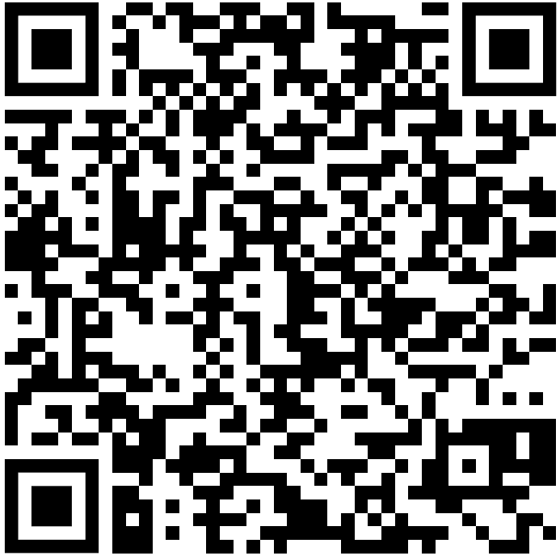
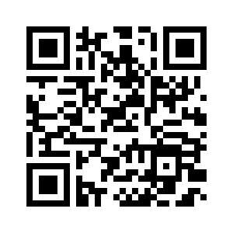

Thanks for a great year of NHS!
Hope you all have a great summer!
Attendance:
Annual Membership Survey:
GroupMe:

